Slide 1

LUHA Company
AI Generative language learning Company

Slide 2

Introduction
Luha Company is an AI generative company where language learning meets innovation and inspiration.
At Luha, we're passionate about empowering youths and teenagers to embark on a journey of linguistic discovery and cultural exploration.
We redefine language learning for the modern age and unlock the boundless possibilities that come with fluency and cultural understanding

Slide 3

MISSION: To revolutionize language learning for youths and teenagers by providing accessible, engaging, and innovative educational experiences.

Slide 4

Language barriers, in today's interconnected world, present significant obstacles for youths and teenagers striving to thrive in an increasingly globalized society.
Traditional language learning methods have failed to engage and empower young learners, resulting in disinterest, frustration, and limited proficiency.
Problem
Learning programming languages has also been a strenuous process as many do not have adequate information on which ones to start with in regards to the fields they'll venture into or even their interests.

Slide 5
Data Findings
9/10
70%
21%
people believe learning a second language is important.
of those who didn't learn a second language regret not doing so
have missed a career opportunity because they didn’t know a second language.

Slide 6

Solution
Through innovative technology, interactive curriculum, and a supportive community, Luha Company, aims to transform language learning into an engaging, accessible, and empowering experience for young learners.
A user friendly AI will be used in our website and app to generate a platform for a summarized collection of related language learning videos when prompted; including animated videos and the natives' culture.
Moreover, suggestions will be aired on the best languages to start with.
The Open AI will be an image generator thus helping learners to upload images to generate cultural and other learning answers.
​

Slide 7
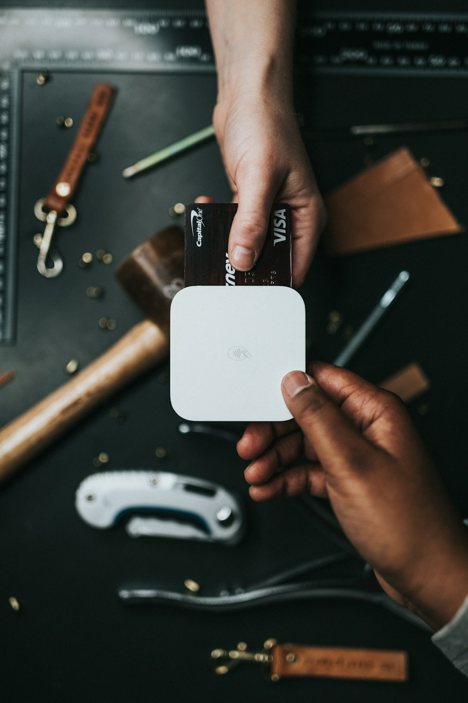
Our Product
Discover Luha: Where AI-driven language learning meets cultural immersion.
Our platform redefines education for youth, seamlessly integrating innovative AI technology with interactive experiences.
Join us in unlocking the boundless possibilities of fluency and cross-cultural understanding.
Some of our unique features are:
1. Personalized Learning Paths: Tailored lessons cater to individual progress and preferences.
2. Interactive Conversational Practice: Engage in realistic dialogues and cultural scenarios for immersive learning.
3. AI Feedback and Assessment: Receive instant, AI-powered feedback and track progress with detailed insights.
4. Community Engagement: Connect with peers and native speakers for collaborative learning experiences across devices.

Slide 8


Slide 9
Market size
2.3B
452.9M
45M
TOTAL
AVAILABLE MARKET
SERVICEABLE
AVAILABLE MARKET
SERVICEABLE OBTAINABLE MARKET
TAM
SAM
SOM

Slide 10



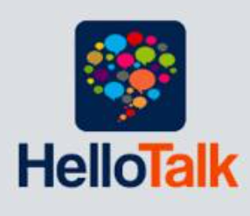
Competitors
Duolingo
Memrise
HelloTalk

Slide 11

COMPETITION
Competitive Advantages
1. Cutting-edge AI Technology: Advanced AI ensures personalized learning and real-time feedback.
2. Holistic Learning Approach: Integration of cultural immersion and community engagement for comprehensive learning.
3. Scalability and Accessibility: Multi-platform accessibility caters to diverse users, from individuals to institutions.
4. Community-Centric Ecosystem: A vibrant community fosters collaborative learning and cultural exchange.

Slide 12



Business Model
*
$$$
INDIVIDUALS
ENTERPRISE
*
Creatives, freelancers
Corporations, professional services
TEAMS
Startups, agencies, SMEs

Slide 13
At Luha, we're committed to revolutionizing language learning for youth worldwide.
Join us on this journey of linguistic discovery and cultural exploration.
Together, let's unlock boundless possibilities through fluency and cross-cultural understanding.
Contact us to learn more about how we can collaborate and make a difference.
Contact info:
susangicheru07@gmail.com

